Slide 1
Hysteroscopic Sterilization (Essure) Kristina Tocce, MD, MPH Student Program Director Assistant FP Fellowship Director Department of Ob/Gyn University of Colorado
“Bayer and Kristina Tocce are providing the content of this presentation to you for informational and educational purposes only.

Slide 2
Workshop Leaders
Colleen Church: Bayer
Nicole Balazs: Bayer
Juliana Melo: 2nd year CO FP Fellow
Lisa Goldthwaite: 2nd year CO FP Fellow
Merritt Evans: Ob/Gyn Kaiser SF, Patient Safety Fellow
Kara Leach: 3rd year FM resident, Swedish
University of Colorado MSFC leaders:
Georgia McCormick
Hannah Scarborough
Leslie Palacios-Helgeson
Elaine Scholpp

Slide 3
Essure: Pioneering Hysteroscopic Sterilization
FDA approved in 2002
>10 years of commercial experience
750,000+ procedures worldwide
300+ publications/abstracts
Patient Satisfaction¹
99% of patients rated their long-term comfort as “good” to “excellent”
No major complications reported during clinical trails
1. Data on file, Concetpus, Inc

Slide 4
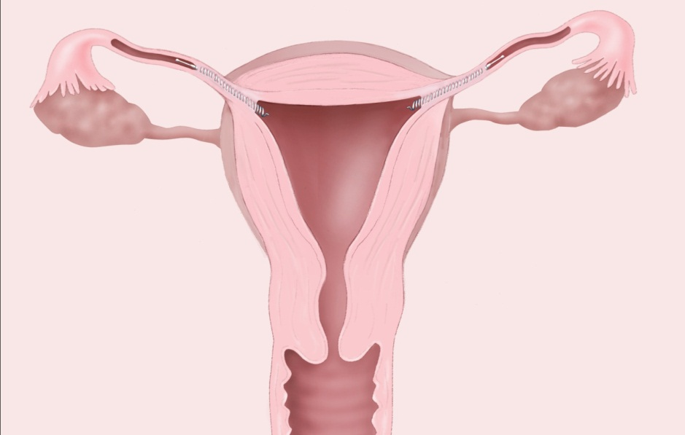
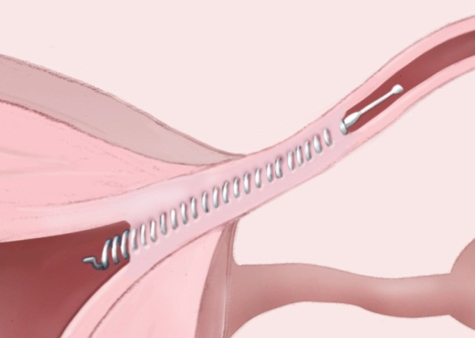
The Essure Procedure
Hysteroscopic approach
Radiopaque inserts placed in the proximal portion of the fallopian tube
Dynamic outer coil anchors insert
Tissue ingrowth occurs through the insert creating natural barrier
99.83% effective*
3rd Generation Delivery System
Techniques are perfected
System is easy to use
Inner Coil
PET fibers create 3cm occlusion
Outer Coil
maintains placement
during ingrowth
*Based on five year clinical trial data
.
Notes:
4

Slide 5
The Essure Insert
Soft, flexible, super-elastic design
Proven materials used for decades in medical devices
Non-incisional
No added hormones
No requirement for general anesthesia
Notes:
Takeaways:
(Pass around insert in the vial)
Soft, light and flexible
Does not contain hormones or silicone; Does not contain or release hormones
Made from materials used successfully for decades in medical procedures such as heart (heart stents) and other surgeries
The tissue response has been found to be:
Reliable – 100% of patients with correct placement had occlusion
Localized to the insert
References: N/A
Rev history: Staff Training – CCXXX; CC-0618 29APR09F

Slide 6
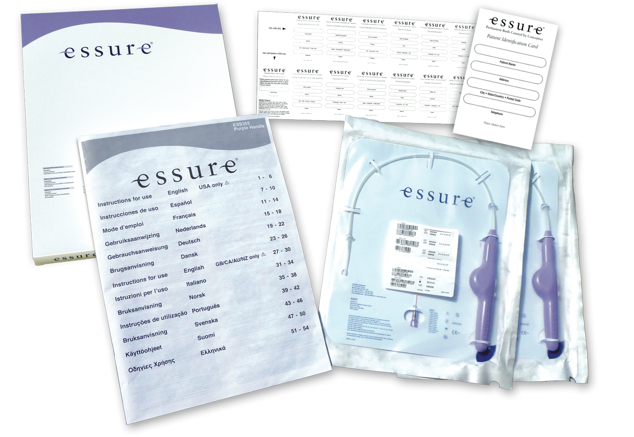
Contents of Essure Kit

Slide 7
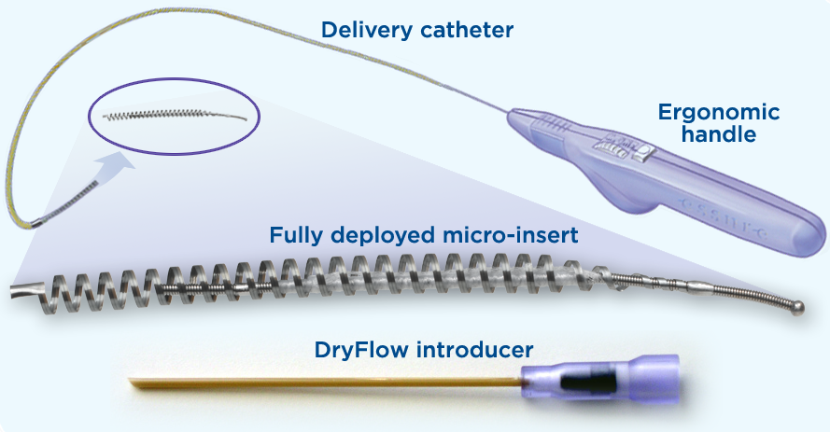
Essure System

Slide 8
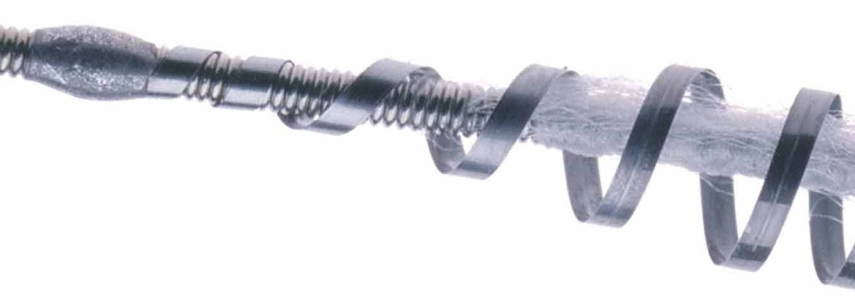
The Essure Insert Design
Device Length: ~3.85 cm
PET Fiber Length: ~1.75 cm
Expanded Outer Diameter: 1.5 – 2.0 mm
Inserts are visible by X-Ray, Ultrasound, MRI and CT Scan
PET Fiber
Dynamic Expanding Super elastic Nitinol Outer Coil
Stainless Steel Innercoil
Notes:
polyethylene terephthalate (PET) fibers

Slide 9
Benefits from Hysteroscopic approach:
Avoid general or regional anesthesia
Faster recovery and return to activities
Avoid risk of trocar injury
Avoid pneumoperitoneum
Can be performed in office setting
Reduced cost
Notes:
9

Slide 10
Essure: Mechanism of Action
Expansion of outer coil for acute anchoring
Space filling/mechanical blockage of tubal lumen
Tubal occlusion complete, at 3 months, by tissue ingrowth (elicited by PET fibers) into and around the insert

Slide 11
Clinical Data Review

Slide 12
Long Term Methods: 5-Year Failure Rate Comparison*
*Baeed on five year data. No direct comparative data exists.
Conceptus, Inc. Data on file..
Peterson HB etal. The Risk of Pregnancy after tubal sterilization: finding from the U. S. Collaborative Review of Sterilization. Am J Obstet Gynecol. 1996 Apr: 174 (4); 1161-8
Mirena Prescribing Information 10/2009
Jamieson DJ etal. The Risk of Pregnancy after Vasectomy Obstet Gynecol. 2004 May; 103(5):848-50.
Notes:
This is a comparison of Essure at five years to other long term methods of birth control. When a patient tells you that her family is complete, review this data with them.

Slide 13
Conceptus Clinical Trial Data Effectiveness
Essure Pivotal/Phase II Trials Results (N=643)
0 Pregnancies
99.83% Effectiveness Rate at 5 years
Age-adjusted Posterior Cumulative Effectiveness Rates (posterior means) for Essure – Phase II and Pivotal Trials Combined*
1 year | 2 years | 3 years | 4 years | 5 years
99.97% | 99.93% | 99.90% | 99.87% | 99.83%
Notes:
No pregnancies in Essure clinical trials.
Peterson HB, Xia Z, Hughes JM et al. The risk of pregnancy after tubal sterilization: Findings from the U.S. Collaborative Review of Sterilization. AJOG. 1996;174:1161-70
The CREST study (Peterson HB 1996) was used as a qualitative benchmark in the Essure clinical trials. The CREST study was based on a multicenter, prospective review of 10,685 women who underwent surgical tubal sterilization and followed for 8-14 years. In previous slide these numbers were listed as “Age-adjusted Posterior cumulative Bayesian effectiveness rates (posterior means) for Essure: Phase II and Pivotal trials combined.*

Slide 14
Bilateral placement rates
Catheter Generation | N | Percent | Average Scope Time
ESS305* | 593/612 | 96.9% | 9 minutes
*ESS-305 Post-Approval Study – Excludes 7 patients in which placement was not
attempted

Slide 15
Essure Tubal Occlusion Results*
% occluded at three months | 96.5%
% occluded at six months | 100%**
* Essure Instructions for Use, CONCEPTUS
** Tubal patency was demonstrated in 16 women at the 3-month HSG, but all 16 women were shown to have tubal occlusion at a repeat HSG performed 6-7 months after Essure placement

Slide 16
Adverse Events Preventing Reliance on Essure in Pivotal Trial
Events | Number | Percent
Expulsion | 14/476 | 2.9%*
Perforation | 5/476 | 1.1%
Other unsatisfactory micro-insert location | 3/476 | 0.6%
Initial tubal patency | 16/456 | 3.5%**
* 14 women experienced an expulsion, however 9 of these 14 women chose to undergo a second micro-insert placement procedure, which was successful in all nine cases.
** Tubal patency was demonstrated in 16 women at the 3-month HSG, but all 16 women were shown to have tubal occlusion at a repeat HSG performed 6–7 months after Essure placement
Notes:
The perforation relates to the device.
Perforations resulting from device placement occurred in 5 women (1%) with no resulting adverse symptoms.
There were no serious adverse events that required an overnight hospital stay.
The eports of pain and bleeding adverse events that were reported during the trial are kept in perspective when looking at satisfaction with Essure .

Slide 17
Patient Satisfaction¹ Essure in the office setting with local anesthesia (n=209)
High patient satisfaction 4.7 ± 0.71 (scale 1–5)
70% experienced discomfort equal to or less than their menses
98% would recommend to a friend
Levie M, Weiss G. et al. Analysis of Pain and Satisfaction with office based Hysteroscopic Sterilization. Fertil Steril. 2010 Sep;94(4):1189-94
Notes:
Takeaway: Studies show that on average patients that undergo Essure in the office setting with local anesthesia find the discomfort to be similar to menstrual cramps. Patients should be counseled to expect some cramping similar to menstrual cramps. In a small number of patients, cramping can get intense. It is impossible to predict how a woman will respond. Patients should be reassured that, if at any time, discomfort becomes unbearable, that the procedure can be stopped and rescheduled in the OR.
Ask audience to share any personal stories.
References: Levie M, Weiss G. et al. Analysis of Pain and Satisfaction with office based Hysteroscopic Sterilization. Fert Ster 2009 epub ahead of print
Rev history:

Slide 18
Recommended Protocol for Patient Comfort
Oral anxiolytic agent
Oral narcotic pain reliever
NSAID* – strongly recommended before procedure (prostaglandin inhibitor)
Oral 48 hours prior
IM or IV on the day of procedure
Paracervical or Cervical Block
Rarely use IV sedation
*Administration of an NSAID was shown to increase likelihood of placement success in clinical trials
Notes:
18
NSAIDs: In the Pivotal Trial, “use of nonsteroidal anti-inflammatory drugs before the
procedure was associated with an increased placement success rate. Therefore, it is
strongly recommended that patients be administered an NSAID one to two hours prior to
undergoing the Essure procedure (see Other Physicians Approaches to Pain Management)
Anxiolitic: to reduce anxiety if needed
IMPORTANT: allow enough time for medication to take effect before beginning the procedure
Make sure your staff knows the importance of the timing of administration of these medications

Slide 19
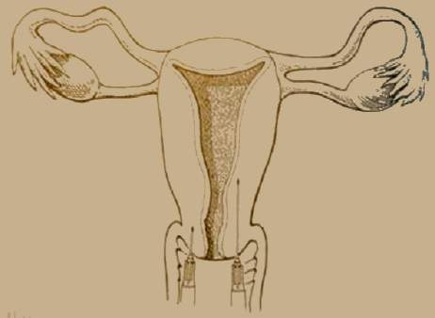
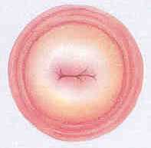
Paracervical Block
Deep Injection
Regular Injection
Castleman L, Mann C. 2002.
Maltzer DS, et al. 1999.
Notes:
Talking Points
Paracervical block is commonly used for vacuum aspiration abortions in North America. However, clinicians use many different techniques for administering a paracervical block. “There is a little science and a lot of art in this area” (Maltzer et al. 1999, p. 77). Studies have shown that deep injections using the Glick technique can be more effective than superficial injections and that injecting slowly has been found to be less painful than injecting quickly.
The trainer may want to be prepared to discuss techniques for administering a paracervical block, because this is a very commonly asked question. Approaches and evidence are discussed fully in the sources listed below.
References
Castleman L, Mann C. Manual Vacuum Aspiration (MVA) for Uterine Evacuation: Pain Management. Chapel Hill, NC: Ipas, 2002.
Maltzer DS, Maltzer MC, Wiebe ER, Halvorson-Boyd G, Boyd C. Pain management. In: NAF’s A Clinician’s Guide to Medical and Surgical Abortion. Philadelphia: Churchill Livingstone, 1999.
- - -
Original content for this slide submitted by the ARHP Clinical Advisory Committee for the Manual Vacuum Aspiration Education Partnership Project in December 2004. Original funding received from Ipas and the John Merck Fund through an unrestricted educational grant. Last reviewed/updated by the ARHP Clinical Advisory Committee for the Manual Vacuum Aspiration Education Partnership Project in October 2007. This slide is available at www.arhp.org/core.

Slide 20
In Office Procedures – Safety is Priority!
Well suited to the office setting
Follow State guidelines regarding anesthesia
Establish written protocols and post them
Staff training on safety
Reference: ACOG Report of the Presidential Task Force on Patient Safety in the Office Setting (ACOG 2010)

Slide 21
Essure Procedure Steps

Slide 22
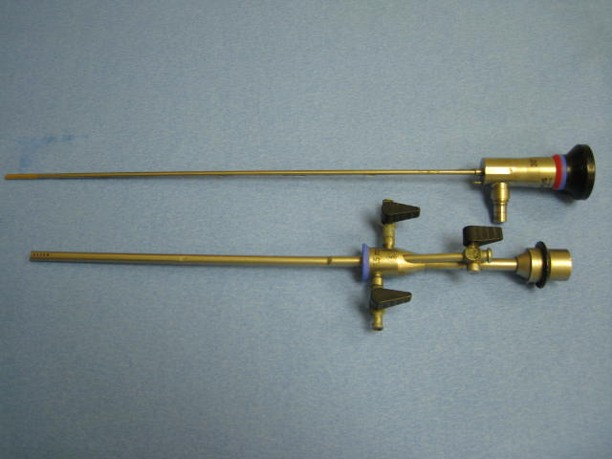
Operative Hysteroscope
IN
OUT
OPERATIVE
CHANNEL

Slide 23
Operative Hysteroscopy
Rigid Telescope
2–4 mm rod
Sheath
5–6 mm outer diameter
Continuous flow
Inflow and outflow port
Operative channel
3 fr
5 fr
Notes:
Flexible with sub bullet to appear first
Rigid and sub bullets to appear second while flexible fades

Slide 24
Fore-oblique Hysteroscopic Lens
Lens
0º
Field of View
0°

Slide 25
Fore-oblique Hysteroscopic Lens
Lens
0º
Field of View
0°
30°
Fore-oblique Lens
12º
25º
30º

Slide 26
Field of View
Field
of
View
Lens – Light Post Relationship
Light post down, field of view up
Notes:
The light cord attachment to the telescope is fixed in a position which is opposite to the field of view. Therefore the light cord can act as a guidepost for maintaining orientation with in the uterine cavity.

Slide 27
Field of View
Field
of
View
Lens – Light Post Relationship
Light post down, field of view up
Notes:
The light cord attachment to the telescope is fixed in a position which is opposite to the field of view. Therefore the light cord can act as a guidepost for maintaining orientation with in the uterine cavity.

Slide 28
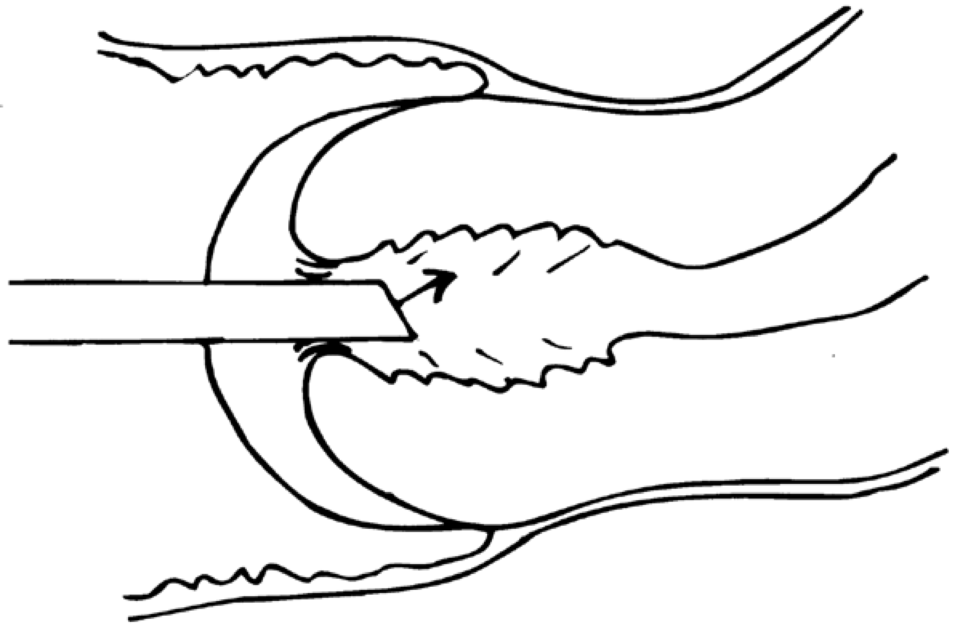
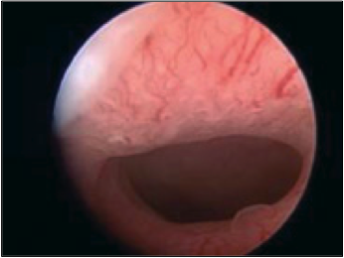
Hydrodilation of the Cervix
Allow the saline to distend the cervical canal
Direct visual access into the uterine cavity

Slide 29
Normal Uterine Cavity
Notes:
Static

Slide 30
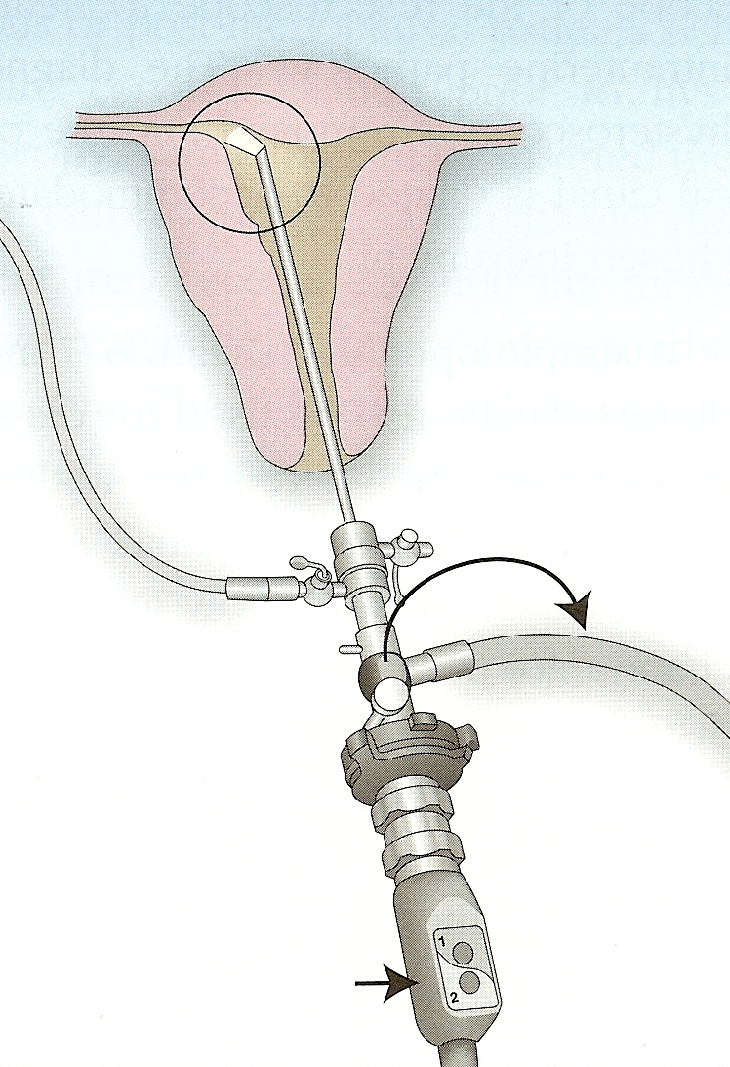
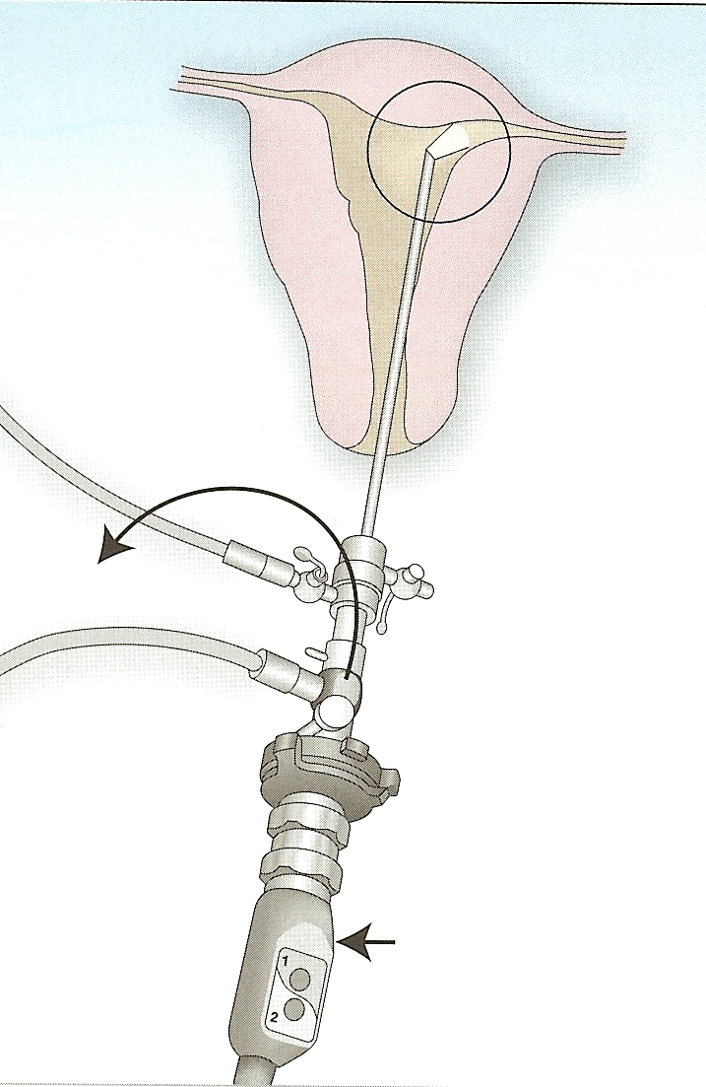
Visualization of the Tubal Ostia With a 30° Hysteroscope
Camera at 12:00
Camera at 12:00
Right Osteum:
Light Post to Patient’s Left
Left Osteum:
Light Post to Patient’s Right

Slide 31
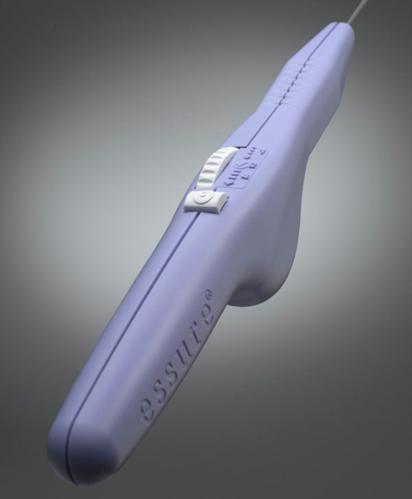
ESS305 System
Ess305 System consists of (1) Delivery System; (2) Insert; and (3) DryFlow Introducer
1.
2.
3.

Slide 32
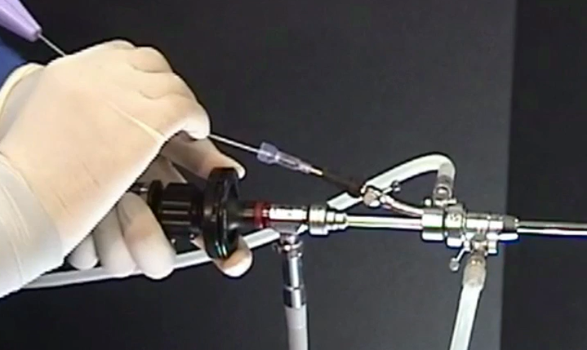
1. Place Dry Flow™ Introducer
One-way valve minimizes splash back
Protects Essure insert upon insertion
Placed into working channel of hysteroscope

Slide 33
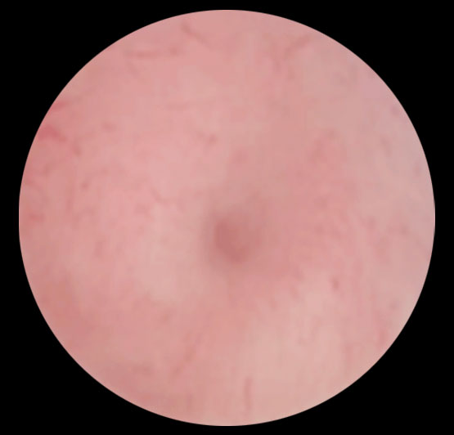
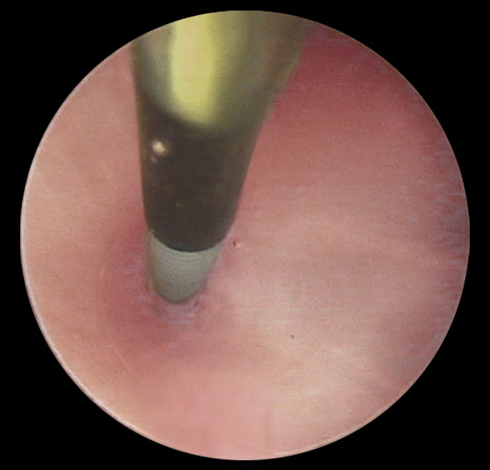
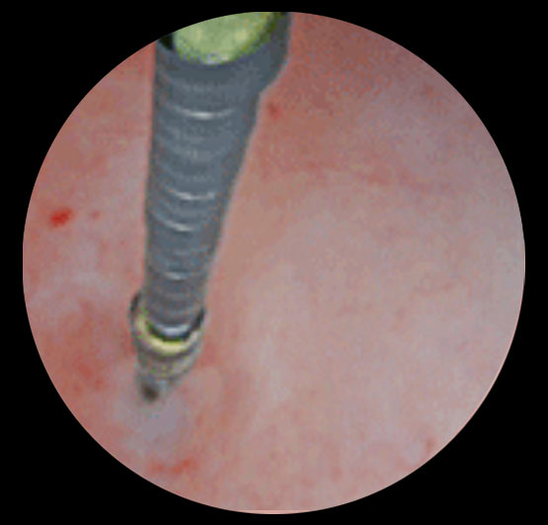
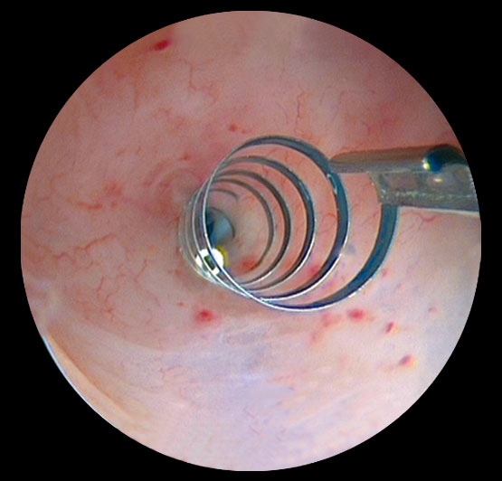
Essure Placement and Deployment
1. Ostia Visualized
2. Delivery Catheter Positioned
3. Release Catheter with Gold Band
4. Insert Positioned
Gold Band
Notes:
33
Takeaway: Key steps in device placement as viewed through the hysteroscope.
Image 1
Uterus distended with physiologic saline
Tubal ostium in center of visual field
Identify and assess both ostiahysteroscopically before proceeding to micro-insert placement
Image 2
Delivery catheter advanced until black positioning marker is at tubal ostium
Delivery catheter withdrawn away from micro-insert into operating channel of hysteroscope
Image 3
Gold band is aligned outside the tubal ostium,
Green release catheter withdrawn to expand the insert
Image 4
insert properly positioned and deployed across utero-tubal junction
References: N/A
Rev history:

Slide 34
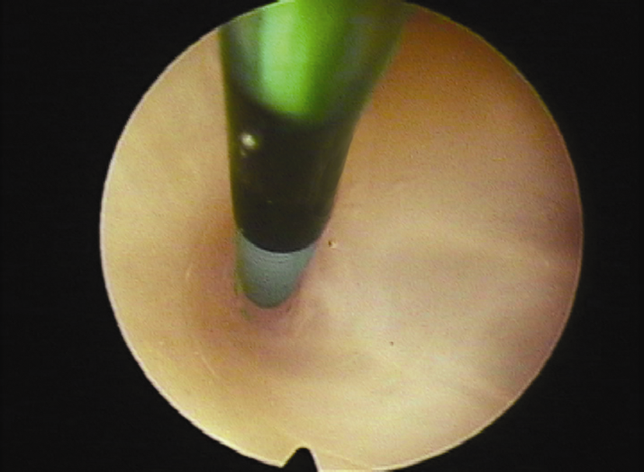
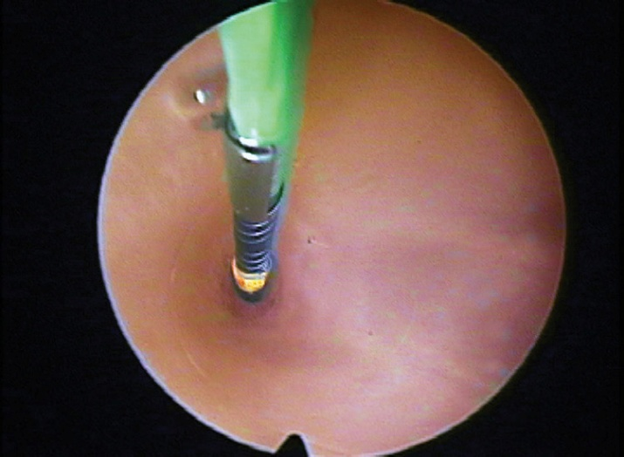
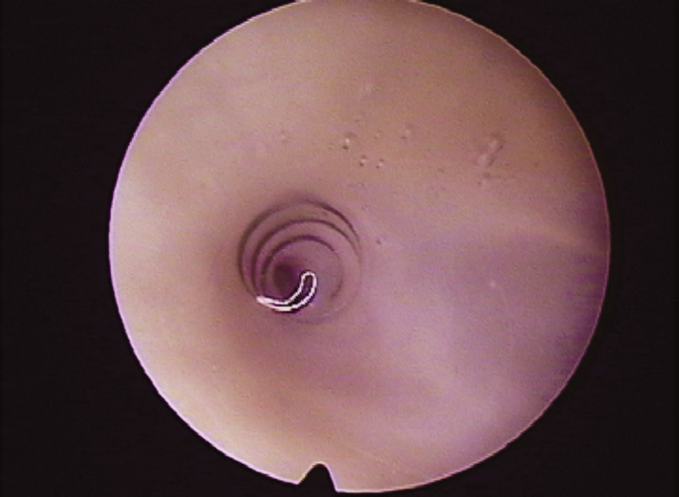
2. Essure Simple Procedure Steps
Insert catheter to black marker – stabilize Essure handle to hysteroscope – wheel button toward you to hard stop
Confirm position = gold band at ostium + green catheter in view
Deploy device = push button, wheel back button toward you to hard stop again while maintaining stabilization
4. Confirm placement and record in notes

Slide 35
Deployed Insert in Tube
Notes:
3-8 trailing coils in uterine cavity is ideal per Instructions for Use.
May have up to 17 trailing coils, if 18 or more are present, use micro-graspers to remove insert by grabbing both inner and outer coil with the instrument. Proceed to remove entire hysteroscope out so as not to drag coil through scope.

Slide 36
Satisfactory Placement
Remove if 18 or more coils visible in uterine cavity
Not enough in tube to prevent expulsion
Remove with Micro Grasper
Grab both inner and outer coils

Slide 37
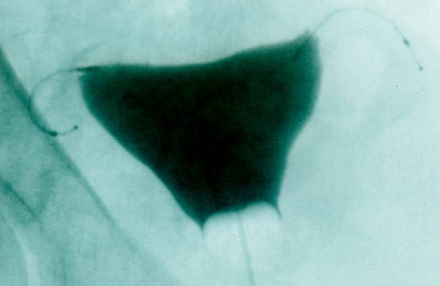
Hysteroscopic Sterilization
HSG at 3 months to document occlusion; repeat at 6 months if not occluded.
Continue birth control.
Outside the US: pelvic x-ray at 12 weeks to document placement.

Slide 38
Stations
High Fidelity Simulator
3 “dry labs”
Counseling Station
Media Station

